Slide 1

A Look at the Relationship between Environments, Economies, and Human Development
Farah, Prinssi, Vaidy

Slide 2
Project overview

Slide 3
What were we trying to accomplish?
Validate or nullify perceived relationship between Happiness, Human Development and Environment
Do environmental variables affect social and economic features
Build “Utopia”

Slide 4
Did it work?
For the most part, of course it was difficult to hone in on how to create a utopia. Given the time and data we were successful.

Slide 5
Summary
Most of the relationships were in line with perception.
Some interesting findings when viewed through gender, per capita bins etc
Some interesting relationships uncovered

Slide 6
Datasets:
Environmental Variables
Country
Accessibility_to_cities:
Elevation
Aspect: orientation of slope
Slope
Cropland cover
Tree canopy cover
Temp max of the warmest month
Rain seasonality/ other train data
Temp – diurnal range
Isothermality
Human Development Index (HDI)
Country
HDI score (0-1)
GNI (Gross National Income)
Population
Internet users
Life expectancy
Dependency ratios
Inequality datasets
Deaths due to Tuberculosis (per 100,000 people)
Deaths due to Tuberculosis (per 100,000 people)
Total fertility rate (birth per woman) 2000/2007
% of population in cities
Secondary education
# of physicians per 10,000 people
Public health expenditure
World Happiness
Country
Happiness Score: A metric measured in 2017 by asking the sampled people the question: "How would you rate your happiness on a scale of 0 to 10 where 10 is the happiest."
Generosity:
Dystopia Residual:
Trust (Government Corruption):
Family:
Health (Life Expectancy):

Slide 7
Data cleanup & exploration

Slide 8
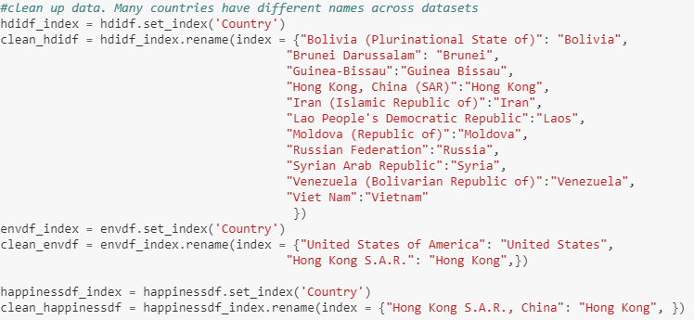
How did we clean up the data
Identify mismatch in country names
Uniform country names
Inner join of countries to maintain data integrity
Notes:
-a lot of country data in some were cities/territories and not countries

Slide 9
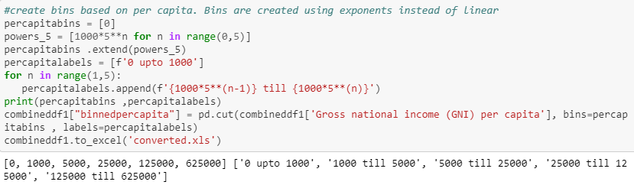
Data exploration
Binning the countries by Gross National Income (GNI) per capita
Binned them by powers of 5 based on data skew

Slide 10
Data analysis

Slide 11
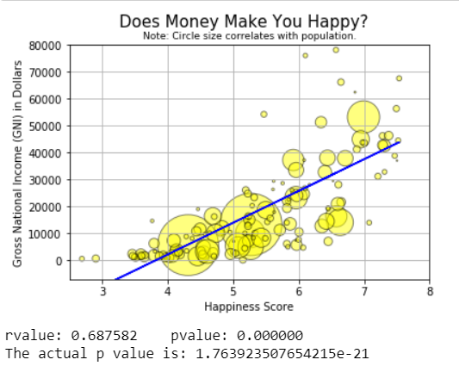
Is there a positive relationship between happiness and GNI? (i.e are people in wealthier countries happier?)

Slide 12
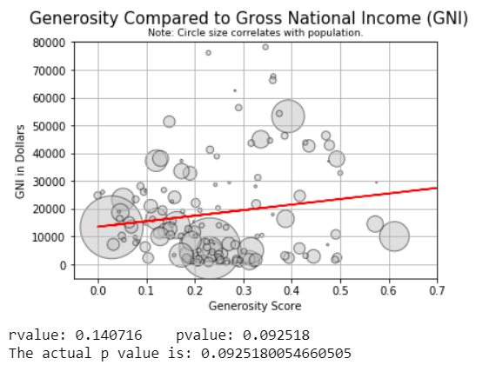
Is there a positive relationship between GNI and generosity?

Slide 13
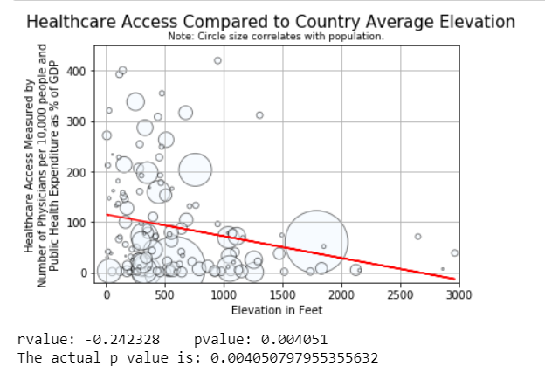
Is there a negative relationship between elevation and access to healthcare?

Slide 14
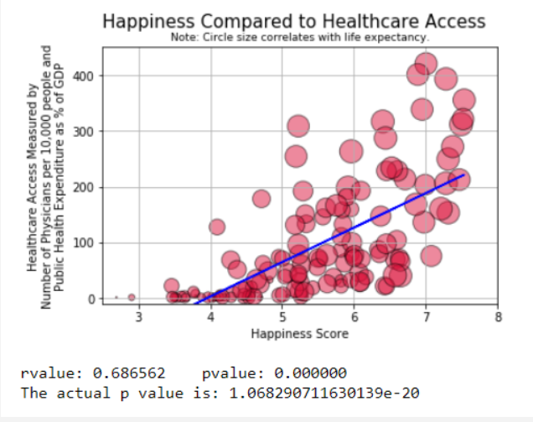
Is there a positive relationship between health and happiness?

Slide 15
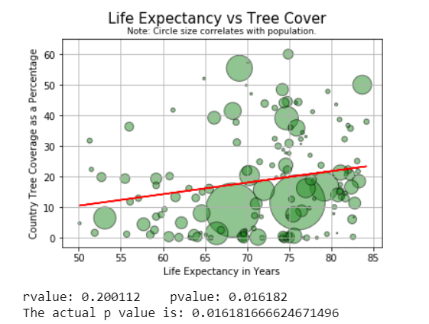
Do people in countries with more tree cover live longer?

Slide 16
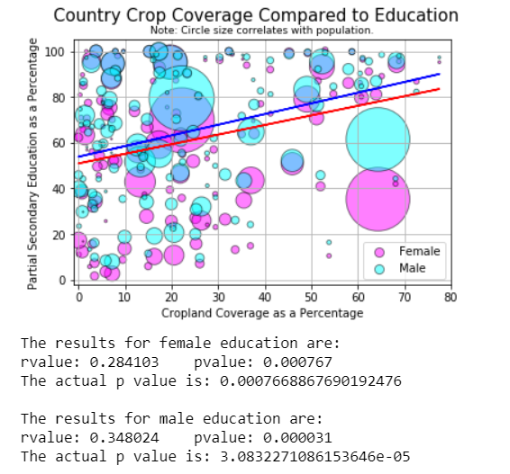
Is there is a negative relationship between crop cover and education?

Slide 17
Utopia - What
How to build a happy colony
Build a model to “learn” with existing data
Create colonies with specific features
Predict Happiness score
What comprises happiest colony?

Slide 18
Utopia - How
Identify correlation between Happiness and other features
Choose the features at extreme ends of correlation
Clean up/fix nulls
Build a model based on above features
Create a colony

Slide 19
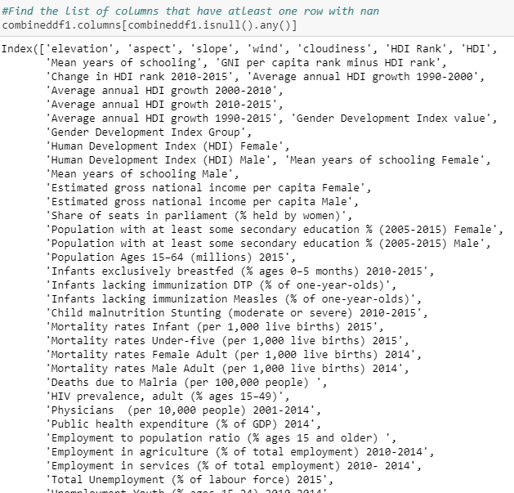
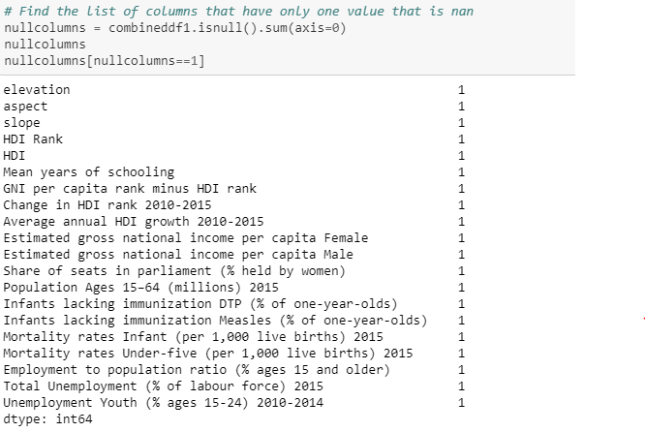
Utopia - How

Slide 20
Introspect….

Slide 21
Looking back
Defining some variables were tricky
GDP was initially how we planned to look at each country’s economy, had to look at GNI instead
General ‘health’ was difficult to hone in on, decided to use access to healthcare, physician stats, life expectancy, and public health expenditure where relevant
Education also had many factors, we used partial secondary education
Data ranged from 2015-17 but only for Happiness Index. So used 2017 for all cases
Due to the plethora of data, we could have addressed several possible relationships & even compiled stats together to do a deeper analysis since variables are not typically independent of each other
Looking at some outlier countries such as India and China and understanding where they may be lacking or innovating
If we had more time, asking tougher/more general research questions would be interesting such as what are key differences between countries with an above average happiness, developed countries, regionality, seasonality, etc.
GitHub and its respective commands were challenging

Slide 22
Thank You. Questions?

